Slide 1
GRAPHS
Notes:
Are your classroom colors different than what you see in this template? That’s OK! Click on Design -> Variants (the down arrow) -> Pick the color scheme that works for you!
Feel free to change any “You will…” and “I will…” statements to ensure they align with your classroom procedures and rules!

Slide 2
What is Graph?
A data structure that consists of a set of nodes (vertices) and a set of edges that relate the nodes to each other
A graph G is defined as follows:
G=(V,E)
V(G): a finite, nonempty set of vertices
E(G): a set of edges (pairs of vertices)

Slide 3
Graphs…
A graph is a collection of vertices and edges
Edges can be directed or undirected
When it has directed edges it is called a digraph /directed graph.
Vertices or nodes are connected by edges
A subgraph is a portion of a graph that itself is a graph

Slide 4
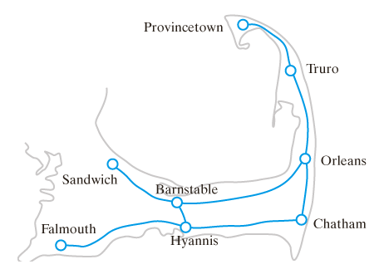
Road Maps
Nodes
Edges
A portion of a road map. Undirected edges

Slide 5
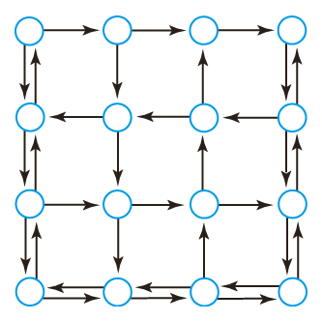
Street Maps
A directed graph representing a city's street map and direction of traffic flow. Directed edges

Slide 6
Directed vs Undirected Graphs
A
V(Graph) = {A,B,C,D}
E(Graph) = {(A,D),(A,C),(A,B),(B,C)}
Two vertices are adjacent in an undirected graph if they are joined by an edge
Sometimes adjacent vertices are called neighbors
B
C
D

Slide 7
Directed vs Undirected Graphs
V(Graph) = {A,B,C,D}
E(Graph) = {(A,B),(C,A),(B,D),(B,A)}
In this directed graph :
A is adjacent to C, but C is not adjacent to A
The order of the vertices while representing the edge is important, (start node, end node)
A
B
C
D

Slide 8
Weight of Edges
If an Edge in the graph has weights / values , the graph becomes a weighted graph.
Weights or costs
Examples of weights
Miles between nodes on a map
Driving time between nodes
Taxi cost between node locations

Slide 9
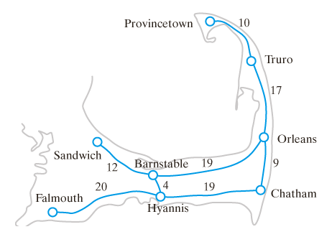
Weighted Graph example

Slide 10
Paths
A sequence of edges that connect two vertices / nodes in a graph
In a directed graph the direction of the edges must be considered
Called a directed path
A cycle is a path that begins and ends at same vertex
Simple path does not pass through any vertex more than once
A graph with no cycles is acyclic

Slide 11
Paths
A path in a graph is a continuous way of getting from one vertex to another by using a sequence of edges.
EG: could get from 1 to 3 as follows:
1-e₁→2-e₄→3
1-e₃→3
e₁
e₆
1
e₂
2
e₃
e₅
e₄
e₇
3
4

Slide 12
Paths
A simple path contains no duplicate edges (though duplicate vertices are allowed). A cycle (or circuit) is a path which starts and ends at the same vertex.
For the previous slide :
Cycle
1-e₃→3-e₄→2-e₂→1
This is also a simple path as no duplicate edges are followed.
Maximal path from 1 to 3 (longest path and contains every edge in the graph)
1-e₁→2-e₅→2-e₆ →2-e₂ →1-e₃ →3-e₄
Also a simple path as there are not duplicate edges.

Slide 13
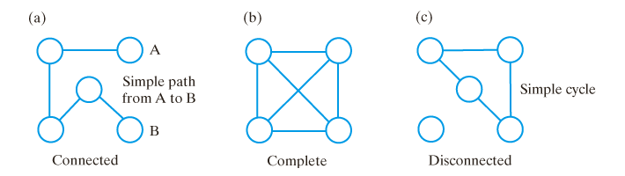
Connected Graphs
A connected graph
Has a path between every pair of distinct vertices
A complete graph
Has an edge between every pair of distinct vertices
A disconnected graph
Not connected

